Slide 1
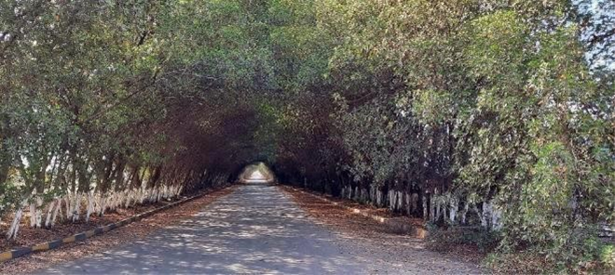
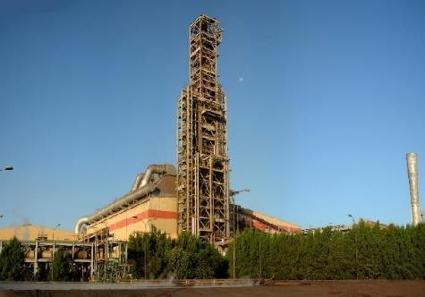
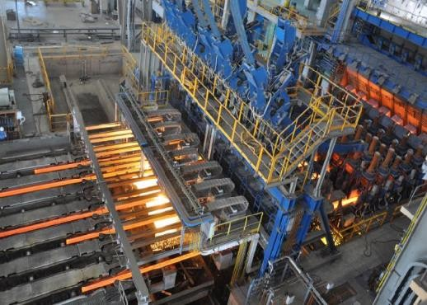

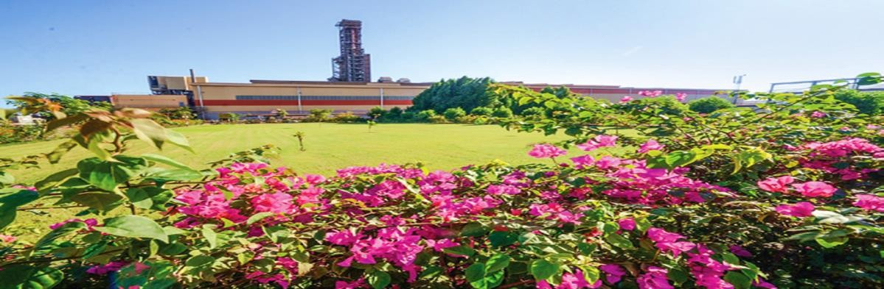
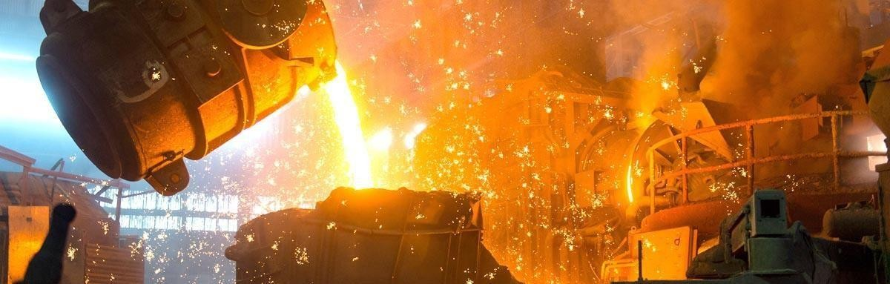

Jindal Shadeed Iron and Steel LLC
October 2022

Slide 2
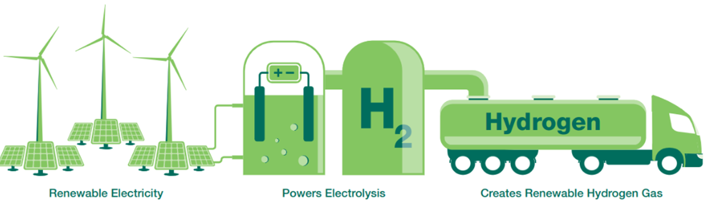
Oman – Strong Potential to be the Sustainability Champion for the World
Enviable Solar Irradiation and Wind Resources – among the top 10 locations in the world
Vast unhabituated lands & seawater– can provide for large green energy projects
Government’s push for National Hydrogen Strategy and Oman 2040 vision

Slide 3
Oman Vision 2040 – Aligned
In Oman’s “Vision 2040” for the future, a favourable environment is developed to attract investments in the Non-Oil sectors by the principle of optimal and balanced use of land and natural resources and the protection of the environment to bring socio-economic prosperity
The 2040 vision aims to ensure Oman is among the ranks of the world’s most developed nations assuring sustained prosperity and security for all.
Vision 2040 sets out the transition of Oman from an oil-based economy to Non-Oil based economy
JSIS aims to invest USD 4bn+ in new plants to partner Oman’s growth story
Source: First Abu Dhabi Bank / IMF/ IIF; Oman Vision 2040 documents

Slide 4


With Collective investments of USD 1.2bn, in country value additions of USD 3.6bn (2014-19), JSIS, the largest private sector steel company in GCC is partnering Oman on the path of industrialization
JSIS is well positioned to Partner Oman’s Vision 2040
Fourth largest steel maker in Arabian Peninsula contributing to 1.7% of Oman’s GDP , change agent by transforming Oman from being the importer of steel to net exporter of steel
Create local employment & contribute to the socio-economic prosperity of Oman
With Omanisation level at 43.7% JSIS has been proactive in embracing and empowering local talent
JSIS is one of the greenest steel plants in the world
At 1.05 tonnes carbon/ tonne of steel vs global avg of 1.82 tonnes carbon/ tonne of steel
Signed an agreement with Hydrogen Rise to evaluate the development of first green hydrogen plant in Sohar
Notes:
In this blue box, pls add JSIS logo

Slide 5

Industrial Excellence & Innovation Awards
His Majesty the Sultan’s Award for Industrial Excellence Three Times in a row
2015-16
2017-18
2019-20

Slide 6
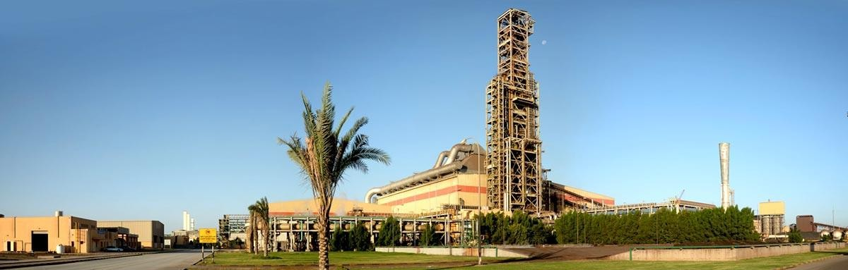















JSIS – At a Glance
CONFIDENTIAL
Oman’s Sole DRI Producer & the GCC’s Largest Integrated Privately-Owned Steel Producer
DRI Plant
Capacity: 1.8 MTPA
Product: HBI/HDRI
Midrex Technology
718 employees
Strong Employee Base
SMS Plant
Capacity 2.4 MTPA
Product: Square / Round Billet
Hot Charging of HDRI
300 Acres /
121 Hectares
Rolling Mill
Capacity 1.4 MTPA
8 – 40 mm Rebars
Jetty with draft of 19m
2 berths,
600 m long
Hot Charging of Billets

Slide 7
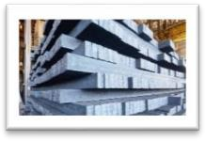
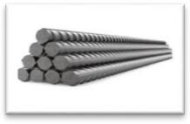
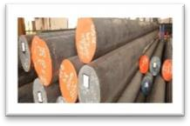
Diversified Product Portfolio
CONFIDENTIAL
Rebars
Square billets
Billets 27%
Section cast- 130,x130, 150x150, 165x165
Structural, Wire Rod, Alloy Steel, WELD MIG, Ball bearing - EN31, Boron treated, High Carbon, Low Carbon, Prestressed concrete grade, Fe500D
Sector: Diverse
Rebars 53%
8-40 mm Premium BGV Finish : QT Box for better physical properties
18 meter length rebar for Europe
Sector: Construction
Rounds 20%
Round billets
Diameter - 200, 220, 280, 350 & 402 mm
Major Grades – Seamless pipe, Seamless corrosion resistance, Tube and Casing, Boiler quality, Seamless mechanical and structural tube and pipes
Sector: Oil & Gas
FY22 Sales: US$ 1,500 mm

Slide 8
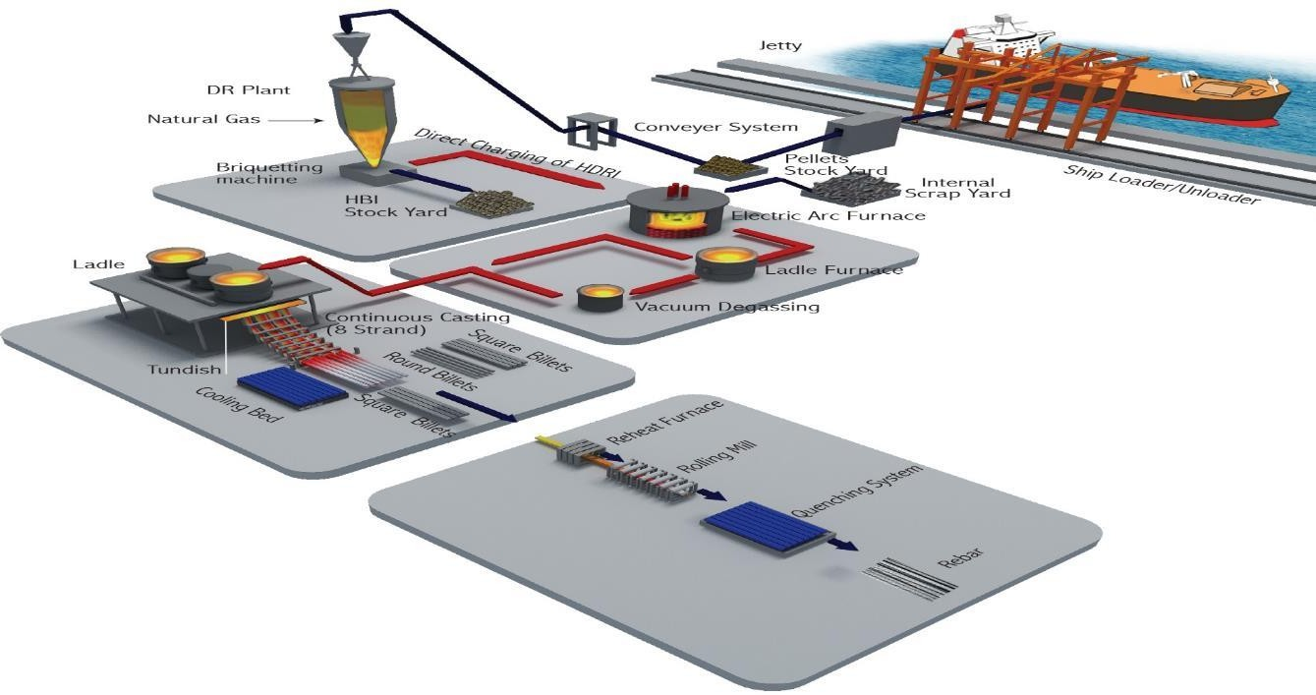
JSIS – A Truly Integrated Manufacturer
CONFIDENTIAL
Global case study of Midrex Technology (DRI Plant)
Strategic Location
Reduced Carbon footprint for Inland Transportation
Reduces Wastage
Worlds Only Plant
Gravity Fed HDRI
Global showcase of Vacuum Degassing technology by Danieli (Edward Pumps-SMS)
Most Advanced Rolling Mill For Re-Bar Production

Slide 9
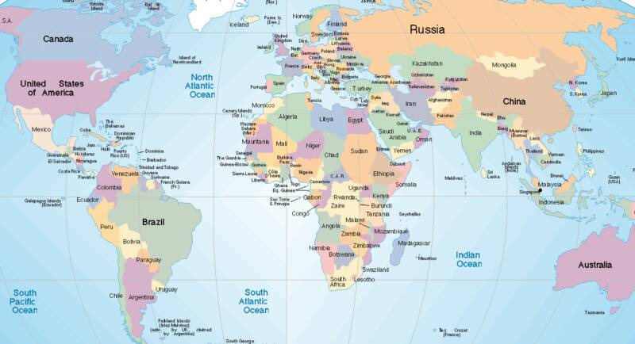
Global Market Reach
Asia: Oman, UAE and Saudi Arabia,Qatar, Bahrain and Yemen, Kuwait, India, Pakistan and Bangladesh, Indonesia, Malaysia, Thailand, Myanmar, Brunei, China ,Taiwan, Philippines, Singapore, Africa: Egypt, Ethiopia, Tanzania, Mauritius Europe: Italy, Germany, North America: USA, Canada, South America: Peru, Australia

Slide 10
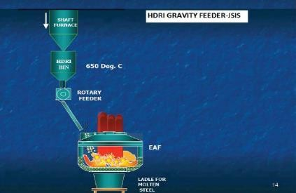
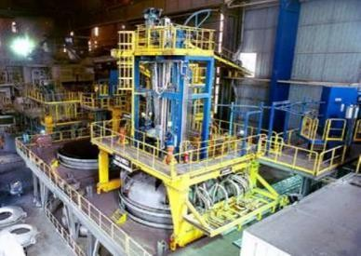
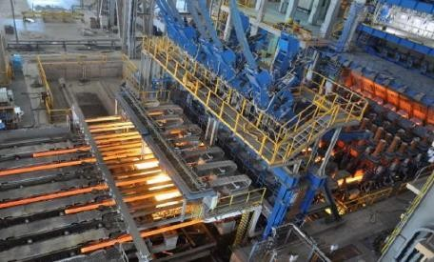
Innovative Technology / Cost Advantage / Environmental Advantage
CONFIDENTIAL
Resulting in operational efficiencies
HDRI – world’s first gravity feeding to EAF at temp > 600 deg c resulting in lower power consumptions |  | World’s largest mechanical vacuum pump system, only company in the GCC having VD system – Providing Customer Delight |  |  | One of the world’s largest combi caster facilities equipped with direct hot charging to rolling mill Energy savings due to lower natural gas consumption in reheating furnace
World Steel Production by Process
Electric Arc _{Furnace} Blast Oxygen _{28%} Furnace 72% |  |  | Currently just over one-quarter of global output is via Electric Arc Furnace (EAF) (including DRI-EAF) JSIS is a leading GCC EAF producer NG DRI-EAF steel making route typically emits 50% less CO₂ in comparison to BF- BOF method, making it environmentally friendlier

Slide 11


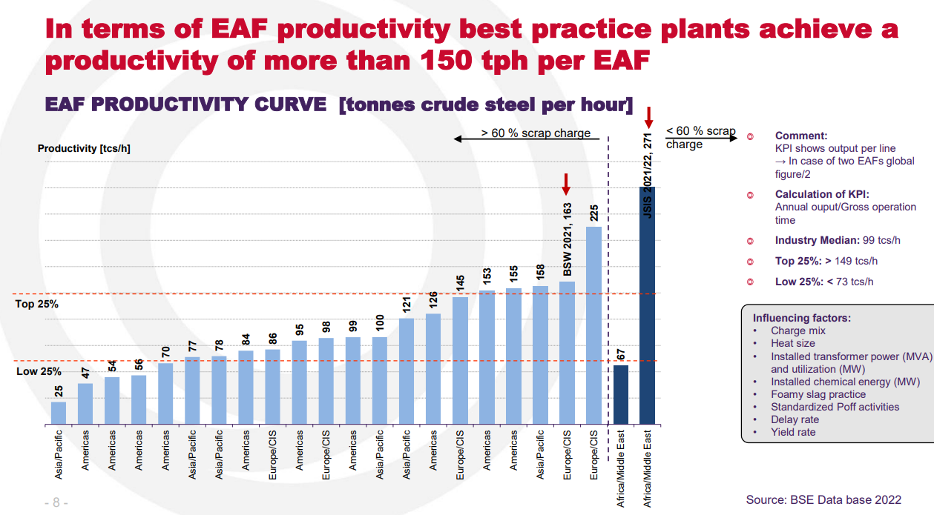
BSE Benchmarking : 21-22
JSIS – Best productivity at 271 TPH on yearly basis
Less than 60% scrap charging plant – JSIS is Best in productivity

Slide 12
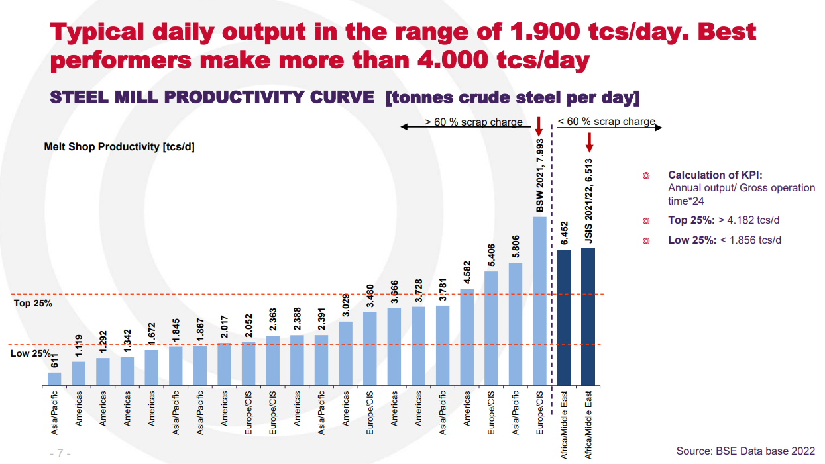
BSE Benchmarking : 21-22
, JSIS @6513 tcs/day
Less than 60% scrap charging plant – JSIS is Best in Melt Shop Avg Productivity/Day for Year

Slide 13
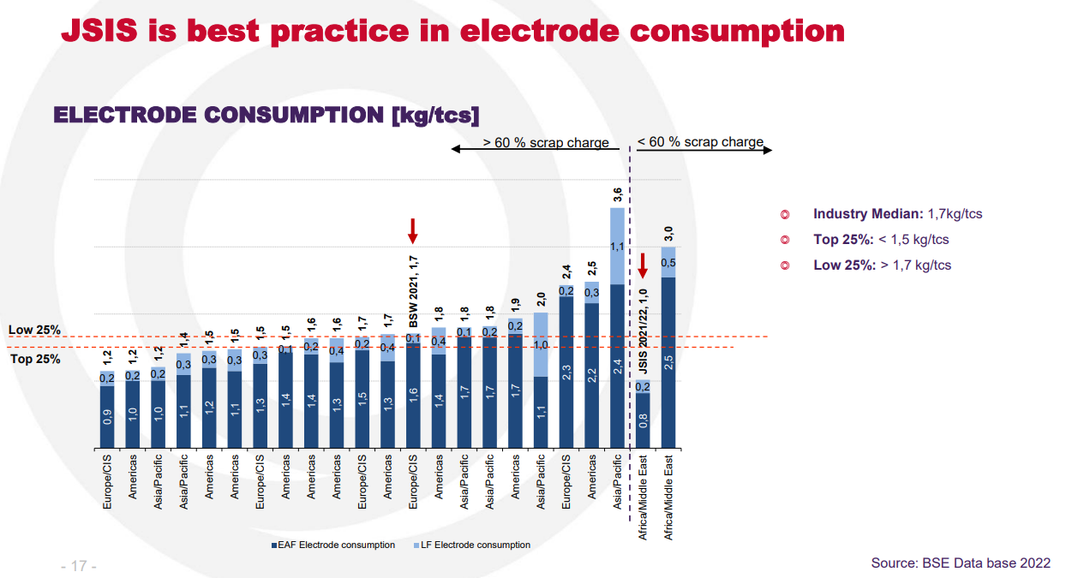
BSE Benchmarking : 21-22
JSIS IS AGAIN THE BENCHMARK FOR ELECTRODE COSUMPTION
at 1kg/tcs
Less than 60% scrap charging plant – JSIS is Best in Electrode Consumption

Slide 14
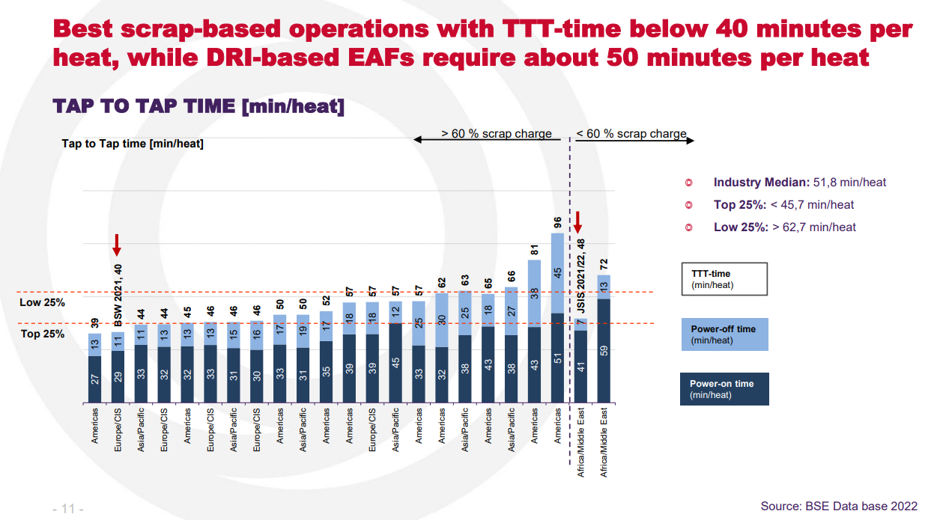
BSE Benchmarking : 21-22
DRI based EAFs require about 50 minutes per heat,
JSIS manages at 48 minutes
Less than 60% scrap charging plant – JSIS is Best in Tap To Tap Time

Slide 15


Environmental Management
CONFIDENTIAL
Several energy saving initiatives in DRI, SMS and SRM. CO2 Intensity of our steel making operation is 1.05t CO2-e/t crude steel (scope 1 +scope2) which is one of the best CO2 intensity value in the Iron and Steel Sector
First steel plant in Oman sharing real time Ambient Air Monitoring Data with Environment Authority
Maintaining 15,000 trees encompassing a green area of 85,000 m². Entire plant periphery is covered with trees of ~12m height.
ISO 14001:2015 Certified Plant operations
UK CARES Sustainable Certificate, Responsible Sourcing Certificate and Environmental Product Declaration Certificate
JSIS is the only Steel Plant in Oman treating and processing slag generated from the Steel Melt Shop

Slide 16

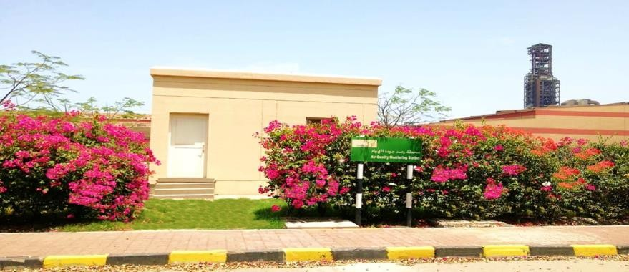
Green Belt Development & Air Quality Monitoring
CONFIDENTIAL
Tree plantation along the road near jetty
View from the garden near Safety department covering DRI tower
Jindal Shadeed has planted more than 15,000 trees and developed lawns over an area of more than 85,000 m²
Air Monitoring Station
Jindal Shadeed is the first company in Oman sharing real time air quality monitoring data with the Environment Authority

Slide 17
Greenhouse Gas reduction measures – Proposed
CONFIDENTIAL
✓
✓
✓
✓
Proposed project for use of Hydrogen in the DRI plant, under advanced stage of project structure formulation
Solar Energy project for replacing part electricity, applied for land.
AI and Machine Learning Technologies for automatic and dynamic process control system for EAF based off gas analysis, implemented in July ‘22.
Carbon capture and storage for net zero target (2050), technology suppliers under evaluation and finalization.

Slide 18
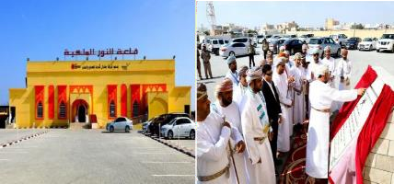
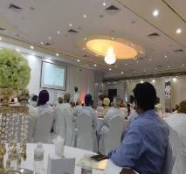
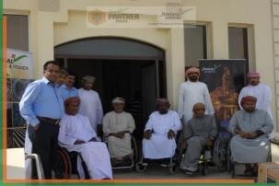
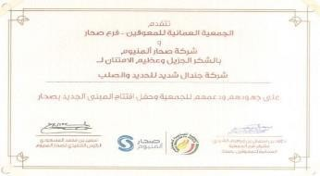
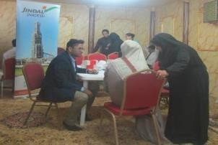
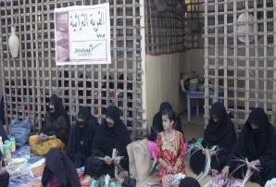
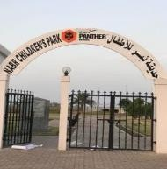
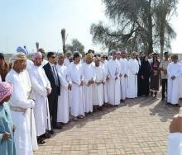
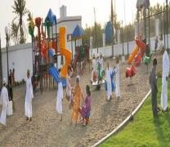
Social Interventions
Al Noor multi purpose hall
Medical equipment to Oman association for disabled
Appreciation letter from Oman association for disabled
Health check up for elderly persons
Support to women’s association
Children park at Nabr, Liwa

Slide 19
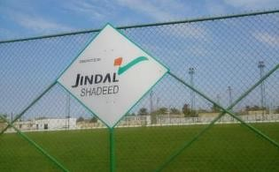
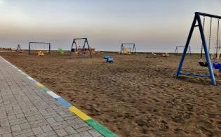
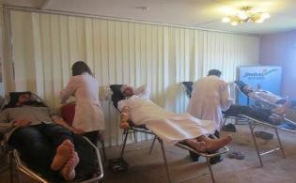
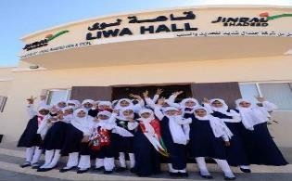
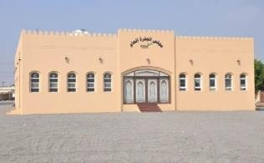
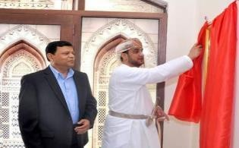
Social Interventions
CONFIDENTIAL
Al Had football ground
AL Rumaila children park, Liwa
Blood Donation
Liwa hall
Majles Al Jaifra, Sohar

Slide 20
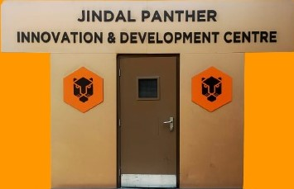
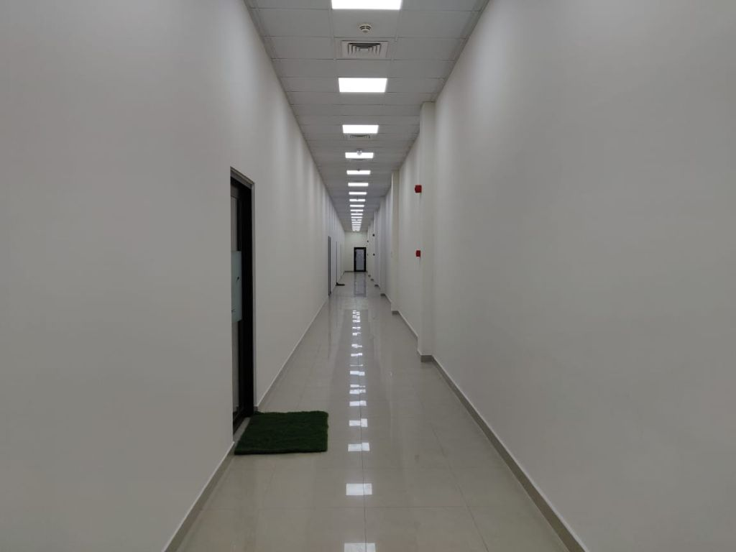
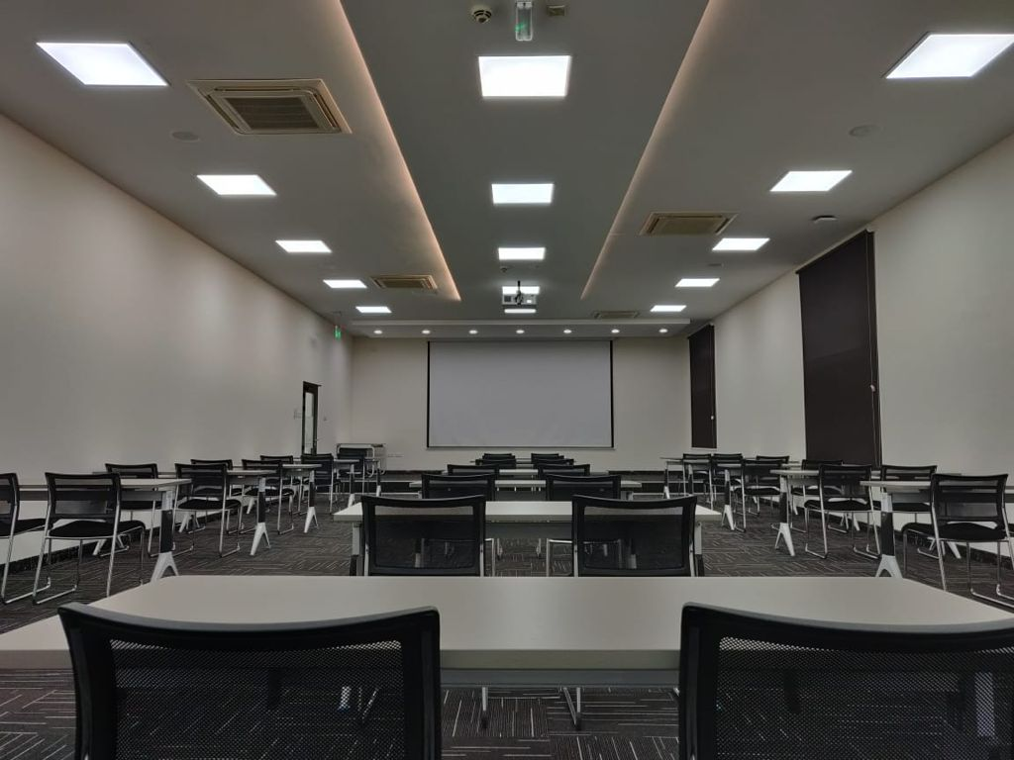
Training Centre : Nurturing Innovation
Technical Development Centre
Leadership Development Programme
Skill Enhancement
Multifunctional hands-on Training

Slide 21
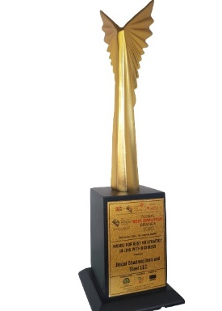
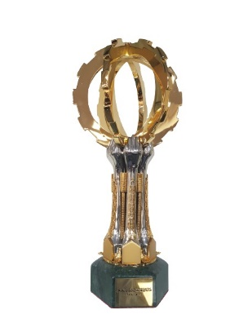
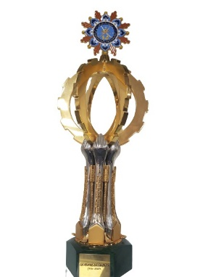
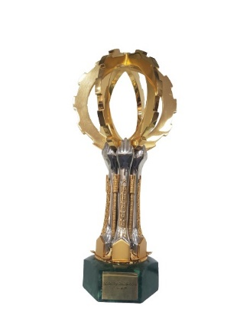
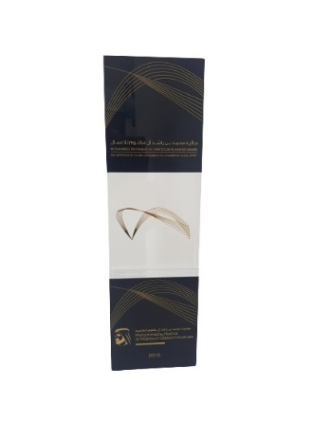
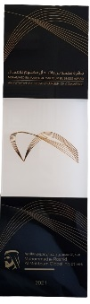
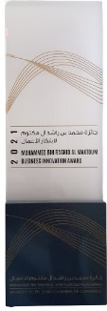
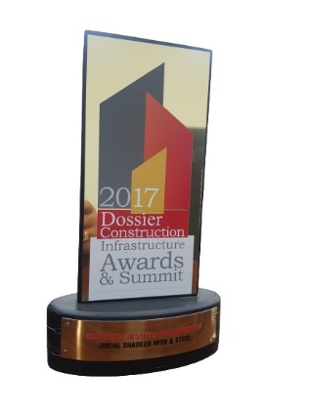
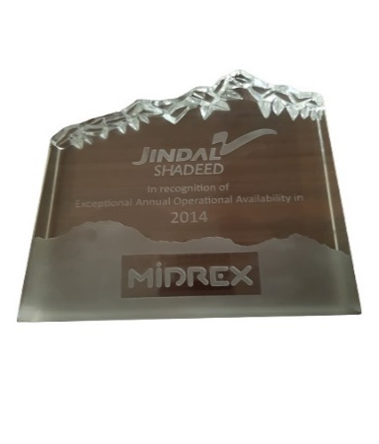
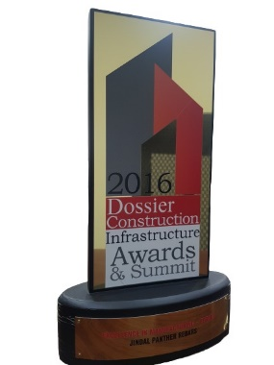
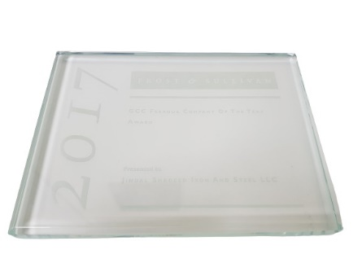
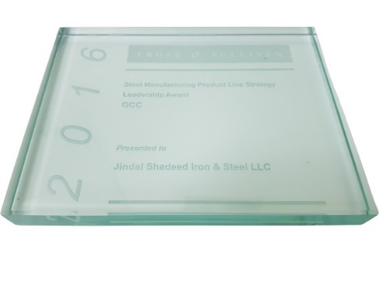
Awards and Recognitions
Global Best Employer 2020
His Majesty the Sultan’s Award 2019-20
His Majesty the Sultan’s Award 2017-18
His Majesty the Sultan’s Award 2015-16
Mohammed Bin Rashid Al Maktoum Business Excellence Award - 2019
Mohammed Bin Rashid Al Maktoum Business Excellence and Business Innovaton Awards- 2021
Dossier Construction Infrastructure Award 2016
Dossier Construction Infrastructure Award 2017
GCC Ferros Company of the year 2016
GCC Ferros Company of the year 2017
Midrex Exceptional Annual Operation
2014
Notes:
For best performance JSIS is being recognized on Global level in every aspect of Business, these are glimpse of the awards received in 10 years of operation.

Slide 22






JSIS Proposed Expansion Plan – 9MTPA Steel capacity by 2027
6 MTPA
Pellet Plant
4.5MTPA Integrated Steel Complex
To Become Largest Green Steel Producer in MENA
2.5 MTPA
SMS
2 MTPA DRI
0.5 MTPA WRM
Strictly private and confidential

Slide 23












Sohar: Expansion of Value Chain of Steel Plant 2.4 MTPA
Current capacity Future capacity
Focus on building Value chain Capacity
Pellet plant
6 mtpa
6 MTPA Pellet Plant
Rebar mill
1.4 mtpa
300 MW Solar Power Plant
DRI plant
1.8 mtpa
EAF SMS
2.4 mtpa
Modification in Rebar Mill for
Oman’s 1st wire mill.
Expansion to
2.0 mtpa
Expansion of DRI to 2 mtpa
Additional investment of more than 0.6 billion USD
Expansion WRM 0.5mtpa
Downstream capacity for producing auto
components, pipes, white
goods, consumer durables
Submerged Arc Furnace 36MVA
Solar plant
500 MW
Total employment 1,500 nos
LDP 2 X 300 TPD

Slide 24




Duqm: 4.5 MTPA Integrated Steel plant to become largest green steel producer in GCC
Current capacity Future capacity
Building Capacity for Potential markets
Integrated Steel complex World’s most efficient and
advanced technology
DRI plant
2.25 mtpa
EAF SMS
2.25
mtpa
CSP mill
3.6 mtpa
LDP
600 TPD
Global Exports of Flat products
Additional investment of
2.4 billion USD
Pellet plant
6 mtpa
Wire rod mill
0.9 mtpa
Leader in Green Steel in
GCC and MEA region
Solar plant
EAF SMS 2.25
mpta
Employment generation of
2000 Nos
600 MW
DRI plant
2.25 mtpa
LDP
600 TPD

Slide 25



Green Initiatives – Decarbonization of the steelmaking process

Slide 26

Hydrogen Economy – JSIS plan is to collaborate with the Government of Oman and create a Renewable power-driven Hydrogen Eco-System in Duqm – initiatives to lead FDI investments from the various participants in the Hydrogen Economy Value chain
Partnership with Hydrogen Rise and learning at Sohar to be extended to create Hydrogen Production and consumption eco-system in Duqm SEZ
To be the leader in Hydrogen production for steel, storage and transportation to meet the allied industries requirements
Facilitate the development of Hydrogen Economy Eco-system - suppliers (Linde / Hydrogen Rise etc), Electrolyser manufacturers (John Cockerill), Storage, Transportation Equipment manufacturers and the potential green Hydrogen customers (Auto / Industries etc)

Slide 27
Oman – Sustainability driven growth prospects
Oman is blessed with all the natural ingredients – Solar radiation, wind and vast lands required for green energy generation.
Oman has strong potential to be a leading producer and exporter of green hydrogen.
Green energy & green hydrogen can become new growth engine for Oman’s economy. It will diversify Oman’s GDP to non-oil sector and will provide for innumerable employment opportunities to Omani youth.
The energy transition to green energy will free up valuable Natural Gas for other more value –generating industries and boost the nation’s GDP.
Following are the key policy interventions required for greater private participation and quicker green energy transition:
Free green energy transmission over electrical grid
Net metering terms for energy charges
Custom duty exemption for green energy and produced in the free zones
Green Energy premium and Renewable Energy Credits
CCS and CCUS – all the free zones must be connected CCS infrastructure to provide decarbonizing opportunity to the tenants

Slide 28
Thank You
CONFIDENTIAL

Slide 29
Annexure

Slide 30














Certifications
CONFIDENTIAL
Kingdom of Saudi Arabia
Kuwait
Australia
CARES- Product Conformity
IS- 2830
DCL - Dubai
UK CARES Sustainability
UK CARES- Responsible Sourcing
Hong Kong
ISO 14001: 2015
ISO 9001: 2015
ISO 45001: 2018
Germany
CARES- Product Conformity
23

Slide 31






Capacity Overview
CONFIDENTIAL
Jetty draft of 19m, 2 berths, vessels carrying 180,000 MT of material, 2 Grab type Ship Un-loader & loader
Total Raw Material Storage of 360,000 MT
DR- 1.8 MTPA gas based Midrex Technology, commissioned on 05.12.2010, major products- HBI & HDRI
Rolling Mill - 1.4 Million ton Capacity
SMS – 2.4 MTPA capacity, 200 T EAF, 200 T LRF, 200 T VD, 8 strand continuous combi caster, Commissioned on 24.04.2014, major products billets, rounds
First and Largest Integrated Steel Complex in Oman

Slide 32
Performance against EU* Emission Limits
CONFIDENTIAL
Steel Melt Shop – FTP Stack
DRI Plant – Ejector Stack
120
100
80
60
40
20
0
200
100
150
mg/Nm3
mg/Nm3
150
105
100
25
25
16
17
50
35
10
4
4.4
10
2.5
9.25
SOx
Norm Actual
0
SOx Actual
Dust
Nox
CO
Dust
Nox
Norm
SRM – Reheating Furnace Stack
STEEL Melt Shop – Dedusting System
500
400
200
400
150
mg/Nm3
150
300
mg/Nm3
100
200
100
100
49
50
35
10
1
1
10
8
0
0
0
SOx Actual
0
SOx Actual
Dust
Nox
Dust
Nox
Norm
Norm
* EU – European Union Best Available Techniques (BAT) Limits

Slide 33

18MTPA Limestone Mining, 2 x 3 MTPA Clinker plants
Limestone & Dolomite Mining
50km
Port
Pithead plant
Cement
3 MTPA Clinker Plant Phase-I 3 MTPA Clinker Plant Phase-II
Solar
30 MW Solar Power plant for captive use by clinker plant
100% of power used to be solar
Municipal waste of DUQM to be used
as green fuel
Employment generation of 750 people
Investment of $500Mn

Slide 34


Duqm: 50km railway line from mines to port to be constructed with $100Mn investment
Oman’s first ever rail line powered by solar
Clinker plants
Limestone & Dolomite Mining
Port
Aluminium Smelter
18

Slide 35









Social Interventions
CONFIDENTIAL
PROJECT EXPRESSIONS-
painting exhibition
PROJECT “THE FENCE- NATIONAL
MEASELS CAMPAIGN”
Ground Breaking Ceremony for Hasad Charity building
Hasad Charity building near completion
Health check up camp at Shinas and others
CAMPAIGN “MEET THE CONQUERORS”
OUTSTRIP THE ILLNESS-
health check up
THE AMALGAM – RAMDAN CAMPAIGNS
THE RECOGNITION by Balqees Girls School Sohar

